Slide 1
BROACHING

Slide 2
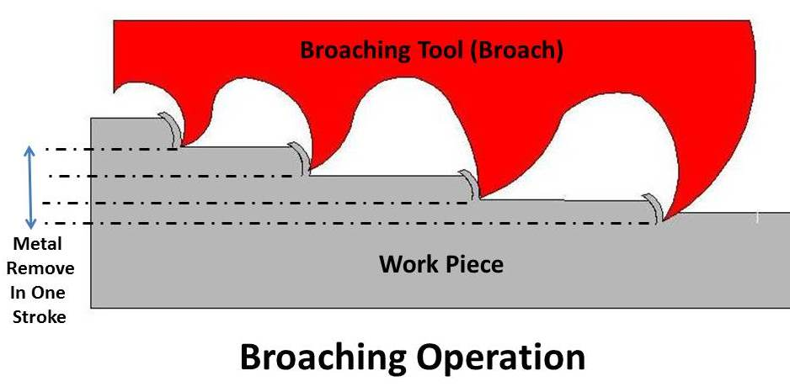
Broaching is a machining process that uses a toothed tool, called a broach, to remove material. There are two main types of broaching: linear and rotary. In linear broaching, which is the more common process, the broach is run linearly against a surface of the workpiece to effect the cut.

Slide 3
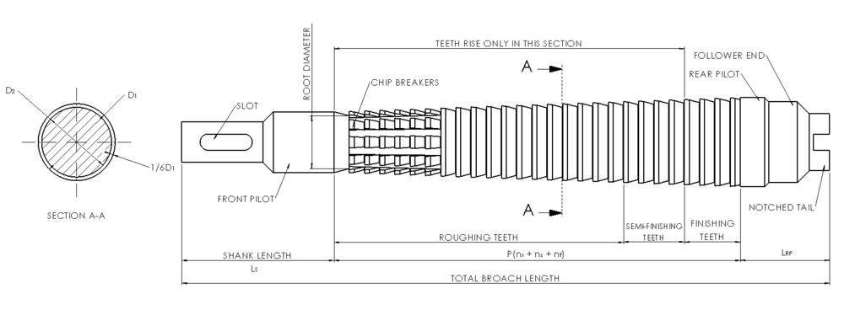
Broach Geometry

Slide 4
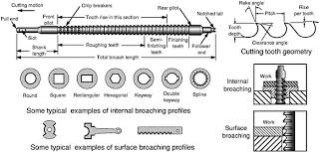
Broaching Tool

Slide 5
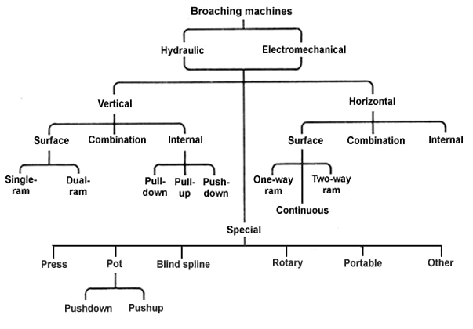

Slide 6
Types of Broaching Machine
1. Horizontal broaching machine
2. Vertical broaching machines
3. Surface broaching machines
4.Continuous broaching machine

Slide 7
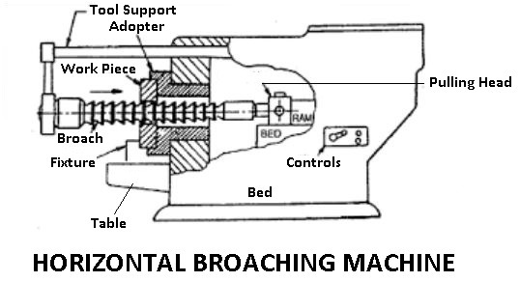
Horizontal Broaching Machine

Slide 8
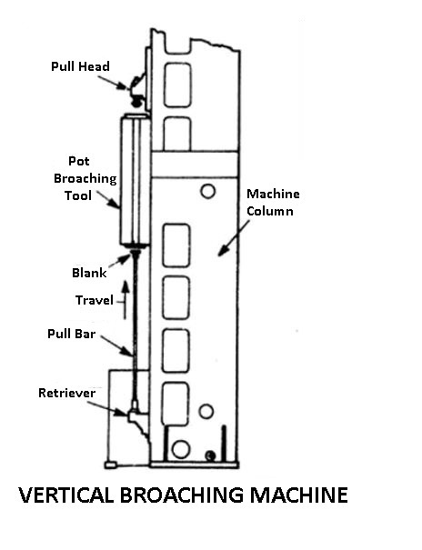
Vertical Broaching Machine

Slide 9
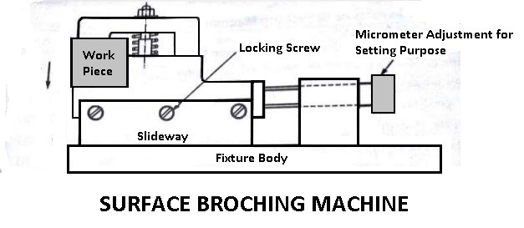
Surface Broaching Machine

Slide 10
Broaching Methods
Following are the classification of broaching methods:
Pull Broaching
Push Broaching
Surface Broaching
Continuous Broaching
Pull Broaching
In the pull broaching the work is held fixed and the broach is pulled through the work. Usually, broaches are very long and are held in a special head. Pull broaching method is used for internal broaching but it also used for some surface broaching.

Slide 11
Push Broaching
In the push broaching the work is fixed and the broach is pushed through the work. Hand and hydraulic arbor presses are commonly used for push broaching. This method is used for sizing holes and cutting keyways.
Surface Broaching
In surface broaching either the work or the broaching tool moves across the other. This method has become an important means of surface finishing. Many irregular or intricate shapes can be broached by surface broaching, but the tools must be specially designed for each job.
Continuous Broaching
In continuous broaching the work is moved continuously and the broach us held stationary. The movement of work may be either straight horizontal or circular. The continuous broaching method is mostly used for broaching a number of similar works at the same time.

Slide 12
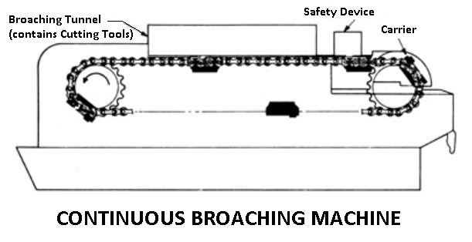

Slide 13
Advantages of Broaching
The rate of production is very high.
2. Skill is required from the operator to perform a broaching operation. In most cases, the operator merely loads and unloads the work-piece.
3. High accuracy and a high class of surface finish are possible.
4.Both roughing finishing cuts are completed in one pass of the tool.
5. broaching process is used for internal and external surface finishing.
6. Any form or shape that can be reproduced on a broaching can be machined.
7. Cutting fluid may be readily applied where it is most effective because a broach tends to draw the fluid into the cut.
The

Slide 14
CUTTING FLUIDS
Cutting fluids are the fluids which are generally applied while the machining(or cutting) operation is taking place.

Slide 15
Functions of cutting fluids
Cool the tool and workpiece
Reduce the friction
Protect work against rusting
Improve the surface finish
Prevent the formation of Built-up edges (BUEs)
Wash away the chips from the cutting zone

Slide 16
Type of Cutting Fluids
Neat Cutting Oils
2. Soluble oils
3. Synthetic Fluids
4. Mineral Cutting Oils
5.Chemical Compounds
6. Sulphurised Mineral Oils

Slide 17
Application Of Cutting Fluids
Flooding
In this method tool and workpiece are supplied with high volume of the cutting fluids which are generally in liquid condition.
Jet application
In this method the cutting fluids which may be either gas or liquid are applied with high pressure on the tool and workpiece.
Mist application
In this method the cutting fluids are mixed with a gas (generally air) and applied to tool and workpiece. Mist application combines the properties of above mentioned both methods i.e. flooding and jet application.

Slide 18
LUBRICANT
A Lubricant is a substance which reduces the force of friction between two relatively moving solid surfaces in contact with each other

Slide 19
Classification of Lubricants
SOLID
Graphite
Zinc oxide
SEMI SOLID
Greases
LIQUID
Vegetable Oils
Animal Oils
Synthetic Oils

Slide 20
Characteristics of Lubricant
VISCOSITY
FLASH POINT
FIRE POINT
POUR POINT
OILINESS
ACID VALUE
VOLATILITY

Slide 21
METHODS OF LUBRICATION
GREASE CUP
GRAVITY FEED
OIL CAN
FORCE FEED
SPLASH LUBRICATION
HAND OILING

Slide 22
Jigs And Fixtures

Slide 23
JIG
It is a work holding device that holds, supports and locates the workpiece and guides the cutting tool for a specific operation. Jigs are usually fitted with hardened steel bushings for guiding or other cutting tools. A jig is a type of tool used to control the location and/or motion of another tool.

Slide 24
FIXTURES
It is a work holding device that holds, supports and locates the workpiece for a specific operation but does not guide the cutting tool. It provides only a reference surface or a device.

Slide 25
Fundamental principles of Jigs and Fixtures design
Reduction of idle time
Study of component
Study of Machine
Rigidity
Location
Loading
Ejection of components
Bushes

Slide 26
Material For Jigs and Fixtures
Timber
Cast Iron
Light Metals
Brasses and Bronzes
Steels

Slide 27
Principle of Location
Location refers to the establishment of a desired relationship between the workpiece and the jigs or fixture correctness of location directly influences the accuracy of the finished product.

Slide 28
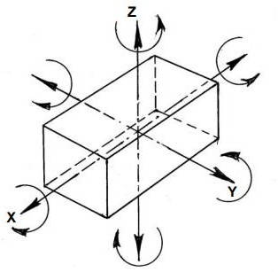
Possible degree of freedom for solid body

Slide 29
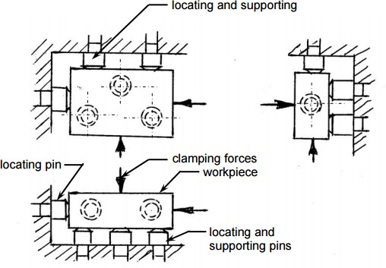
Arresting all degree of freedom

Slide 30
3-2-1 Principle of Clamping Workpiece
It is principle of clamping widely used.
3 Pin are used at Bottom
It will restrict 4 Rotational motion (X,Y Axis) and 1 Translation motion (-Z Direction)
2 Pin
It will Restrict 2 Rotational Motion (Z Axis) and 1 Translation motion in (+X Direction)
1 Pin
It will restrict 1 Translation Motion (+Y)
And Pin 3-2-1 combined will restrict 9 Motion
And Remaining 3 Motion is used to set work-piece at desired location and can be restricted by Clamp.
(*Notation given i.e +X, -X . Changes according to views)

Slide 31
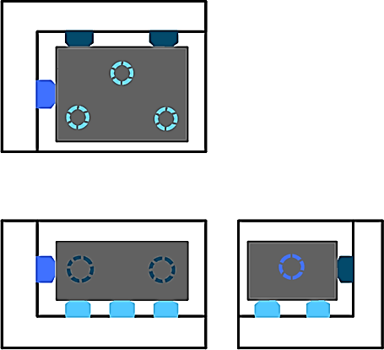
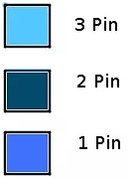

Slide 32
TYPE OF LOCATOR

Slide 33
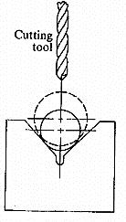

Slide 34
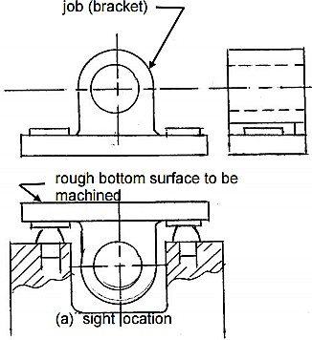

Slide 35
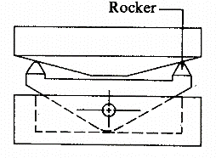
Pivoted arm with two points

Slide 36
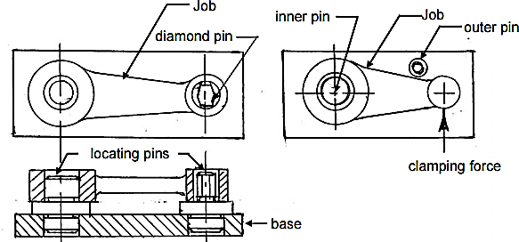
Location by Holes

Slide 37
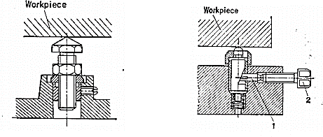
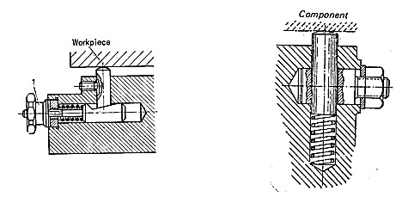

Slide 38
CLAMPING
Once workpiece is located, it is necessary to press it against locating surfaces and hold it there against the force acting upon it.
The tool designer refers to this action as clamping and the mechanisms used for this action are known as clamps.

Slide 39
Clamping Principles
Clamp should firmly hold the workpiece without distorting it.
Should overcome the maximum possible force exerted on workpiece by using minimum clamping force
Easy to operate
Vibrations should tighten the cams and wedges in the clamp design(if any) and not loosen them

Slide 40
Type of Clamping
Mechanical Actuation Clamps
Pneumatic and Hydraulic Clamps
Vacuum Clamping
Magnetic Clamping
Electrostatic Clamping
Non Mechanical Clamping
Special Clamping Operations

Slide 41
Types of Clamps
Screw clamps
Strap clamps
Pivoted clamps
Hinged clamps
Swinging clamps
Quick action clamps
Power clamps
Non-conventional clamps

Slide 42
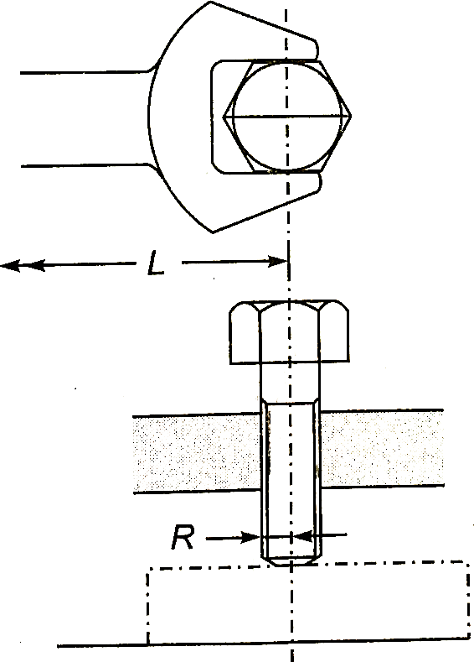
SCREW CLAMP

Slide 43
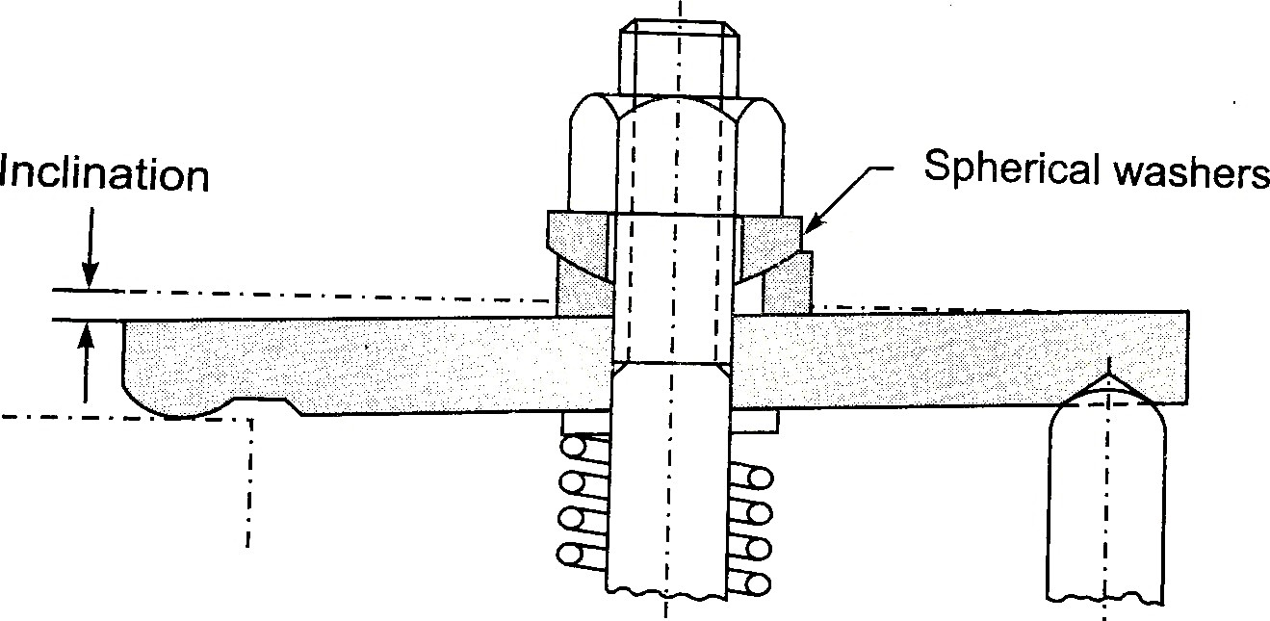
STRAP CLAMP

Slide 44
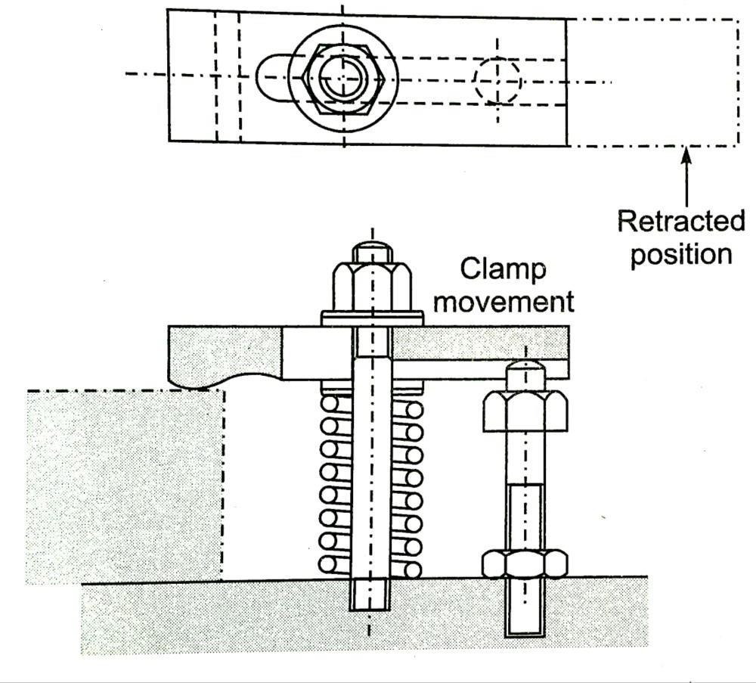
Retactable strap Clamp

Slide 45
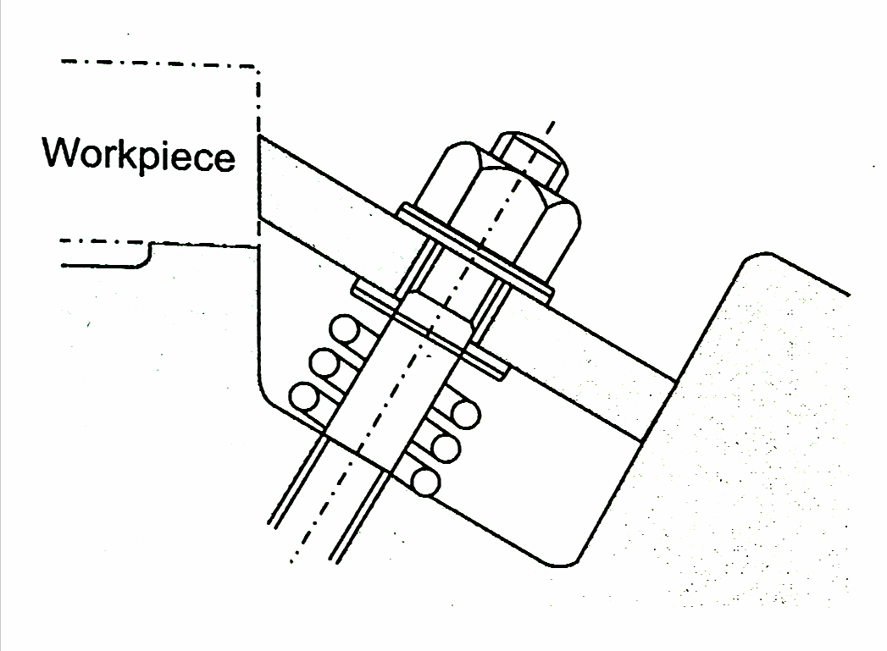
Edge Clamp

Slide 46
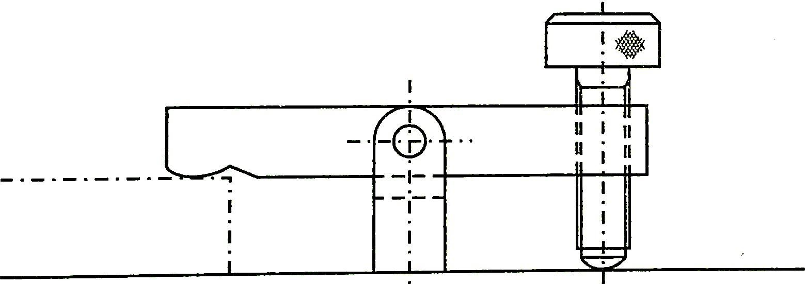
Pivoted Clamp

Slide 47
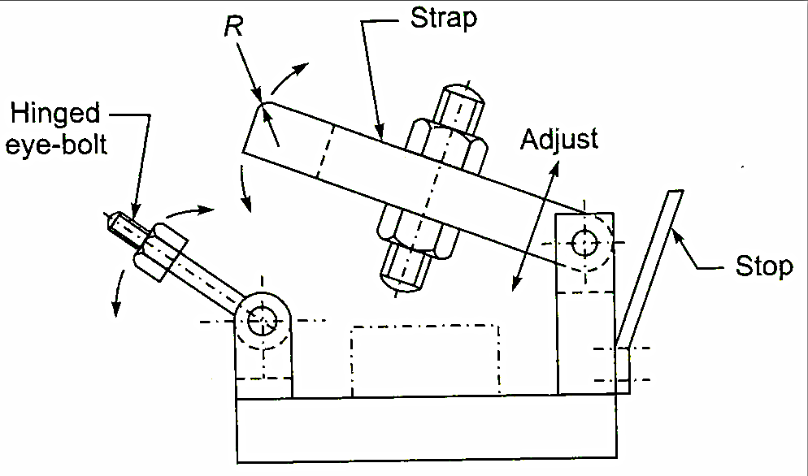
Hinged Clamp

